Slide 1




Slide 2

WARNSDORFF’S ALGORITHM

Slide 3

TEST TIME ON N QUEENS
URL:https://forms.gle/fbopASmReiwLuH8L9
QR CODE:

Slide 4
WARNSDORFF'S ALGORITHM
Introduction:
A knight's tour refers to a sequence of moves a knight makes on a chessboard, ensuring that it only visits every square once.
If the knight ends up on a square exactly one knight's move away from the starting square, the tour is considered closed; otherwise, it is open.
The knight's tour problem is essentially the challenge of finding a solution to this problem.

Slide 5
WARNSDORFF'S ALGORITHM
Problem
Given a N*N board with the Knight placed on the first block of an empty board.
Moving according to the rules of chess knight must visit each square exactly once.
Print the order of each cell in which they are visited.

Slide 6
WARNSDORFF'S ALGORITHM
An open knight's tour of a chessboard

Slide 7
WARNSDORFF'S ALGORITHM
Sample IO
Input
N = 8
Output
1 50 45 62 31 18 9 64
46 61 32 49 10 63 30 17
51 2 47 44 33 28 19 8
60 35 42 27 48 11 16 29
41 52 3 34 43 24 7 20
36 59 38 55 26 21 12 15
53 40 57 4 23 14 25 6
58 37 54 39 56 5 22 13
Explanation
The tour is started from the leftmost corner (marked as 1)

Slide 8
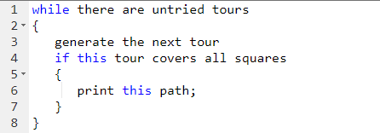
WARNSDORFF'S ALGORITHM
Naive Algorithm

Slide 9
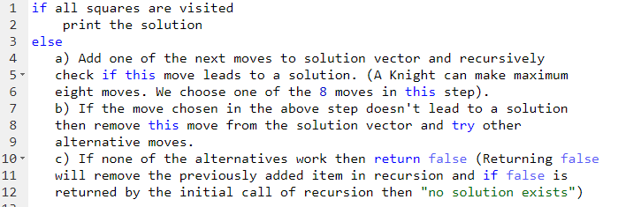
WARNSDORFF'S ALGORITHM
Backtracking Algorithm

Slide 10
WARNSDORFF'S ALGORITHM
Problem
Warnsdorff’s algorithm for Knight’s tour problem
Same problem statement: A knight is placed on the first block of an empty board and, moving according to the rules of chess, must visit each square exactly once.
Warnsdorff's rule is a heuristic for finding a single knight's tour. The knight is moved so that it always proceeds to the square from which the knight will have the fewest onward moves.
When calculating the number of onward moves for each candidate square, we do not count moves that revisit any square already visited. It is possible to have two or more choices for which the number of onward moves is equal; there are various methods for breaking such ties

Slide 11
WARNSDORFF'S ALGORITHM
Warnsdorff’s Rule
We can start from any initial position of the knight on the board.
We always move to an adjacent, unvisited square with minimal degree (minimum number of unvisited adjacent).
This algorithm may also more generally be applied to any graph.
Note:
A position Q is accessible from a position P if P can move to Q by a single Knight’s move, and Q has not yet been visited.
The accessibility of a position P is the number of positions accessible from P.

Slide 12
WARNSDORFF'S ALGORITHM
Warnsdorff’s Rule: Algorithm
Set P to be a random initial position on the board
Mark the board at P with the move number “1”
Do following for each move number from 2 to the number of squares on the board:
let S be the set of positions accessible from P.
Set P to be the position in S with minimum accessibility
Mark the board at P with the current move number
Return the marked board — each square will be marked with the move number on which it is visited.

Slide 13
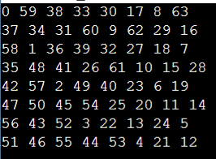
WARNSDORFF'S ALGORITHM
Program
The board size is fixed to 8 here
Output

Slide 14
WARNSDORFF'S ALGORITHM
public class Main { private static final int[] ROW_MOVES = { 2, 1, -1, -2, -2, -1, 1, 2 }; private static final int[] COL_MOVES = { 1, 2, 2, 1, -1, -2, -2, -1 }; public static boolean isSafe(int[][] board, int row, int col, int N) { return (row >= 0 && row < N && col >= 0 && col < N && board[row][col] == -1); } public static void printSolution(int[][] board) { int N = board.length; for (int[] row : board) { for (int cell : row) { System.out.print(cell + " "); | } System.out.println(); } System.out.println(); } public static boolean solveKnightTour(int N) { int[][] board = new int[N][N]; // Initialize the board with -1 (unvisited) for (int i = 0; i < N; i++) { for (int j = 0; j < N; j++) { board[i][j] = -1; } }

Slide 15
WARNSDORFF'S ALGORITHM
// Start the knight's tour from the top-left corner (0, 0) board[0][0] = 0; // Recursive function to find a solution if (solveUtil(board, 0, 0, 1, N)) { printSolution(board); return true; } else { System.out.println("No solution exists."); return false; } } public static boolean solveUtil(int[][] board, int row, int col, int moveCount, int N) { | if (moveCount == N * N) { return true; } // Try all next moves from the current position for (int i = 0; i < 8; i++) { int nextRow = row + ROW_MOVES[i]; int nextCol = col + COL_MOVES[i]; if (isSafe(board, nextRow, nextCol, N)) { board[nextRow][nextCol] = moveCount;

Slide 16
WARNSDORFF'S ALGORITHM
// Recur for the next move if (solveUtil(board, nextRow, nextCol, moveCount + 1, N)) { return true; } // Backtrack: if the move doesn't lead to a solution, undo it board[nextRow][nextCol] = -1; } } // If none of the moves work, the problem has no solution return false; } public static void main(String[] args) { int N = 8; // Board size solveKnightTour(N); } }

Slide 17




THANK YOU
+91 78150 95095
codemithra@ethnus.com
www.codemithra.com

